Slide 1
Computer Applications -Generic Elective

Slide 2
Course Objectives: To provide an understanding of essential Information Technology Concepts and Emerging Technologies. Includes practical skills in data capture, analysis and presentation, report formatting, efficient search techniques and online collaboration tools.
Unit I

Slide 3
Information Technology Basics
Unit I

Slide 4
What is Information Technology?
Information Technology is defined as the technology used to acquire, store, organize and process data to a useful form and distribute the processed data i.e. Information.

Slide 5
Components of IT
IT has Four major components:
Hardware
Software
Data
People

Slide 6
Types of Data
Data is described as individual facts, statistics or item of information.
In other words data are the raw material of Information processing.
The various types of data are Numeric, Text, Graphic, Sound, Video, Animation.

Slide 7
Data Representation – Character Format
Computer and other digital equipments are designed to recognize and use only the binary number system i.e. 0 and 1.
Although many coding schemes have evolved over the years, the most commonly used codes are ASCII and Unicode.

Slide 8
Parts of a Computer
CPU
Memory
Input/ Output Devices
Auxiliary Memory

Slide 9
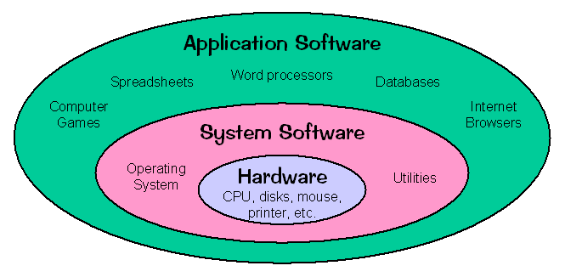
Relationship between Hardware and Software

Slide 10
Operating Systems
An operating system is a set of integrated programs, that manages overall performance and functioning of the computer system by controlling the resources such as CPU, memory, I/O devices and overall flow of information within the system.
Examples: DOS, Windows7, Linux, Unix, OS/2, etc.

Slide 11
Functions of OS
Command interpretation:
Memory management:
File management: -
Process Management: -
Device management: -
Maintenance of data security and integrity: -

Slide 12
Application of IT in the following areas:
Business
Mobile Computing
Health Services
Public Sector
Media
Defense Services
Education and Publication

