Slide 1
CAPITAL MARKET
UNIT I

Slide 2
(A) FINANCIAL MARKET
The financial system of any country covers within its fold the financial markets and financial institutions.
In India, we have treasury bills market, call money market, industrial securities market, foreign exchange market, gilt-edged securities market and so on.
There is no specific place or location to indicate a financial market.
It exists at a place where financial transactions are wide spread within country.

Slide 3
Classification of Financial Market

Slide 4
Organized Market
Organized market is well integrated market which operates as per standardized rules and regulations.
Such market is subject to strict supervision and control of RBI and other regulatory authorities.
Capital market and money market.

Slide 5
Unorganized market
Unorganized market is not well organized and do not function as per well defined rules and regulations.
The operations in such market are as per old and outdated rules and traditions.
Moneylenders and indigenous bankers

Slide 6
Capital Market
Capital market is a financial market that deals with borrowing and lending of long term funds.
It is market for financial assets of long term maturity.
Capital market has three components
Industrial securities, govt securities and long term loans market

Slide 7
Money market
Money market is a financial market that deals with borrowings and lending of short term funds.
It is market for dealing with financial assets and securities with maturity up to one year.
There are four components of Indian money market
Call money market, commercial bills, treasury bill market and short term loan market.

Slide 8
Industrial/ corporate securities market
Industrial securities are the equity and preference shares, debenture and bonds of companies.
Industrial securities market is very sensitive and active financial market.
It is divided in to two market i.e. Primary market and secondary market
Financial intermediaries like merchant banks helps the corporate sector to raise funds in the capital market.

Slide 9
Government securities market
It is a market for transactions in government securities also called as gilt edged securities.
Such securities may be of short term or long term.
Govt. securities includes securities issued by central and state govt., semi- govt. port trust and so on.
Such securities are safe for investment but the return is not attractive.
Commercial banks and charitable trust purchase such securities.

Slide 10
Long term loan market
This market provides long term loans to corporate sector for various purposes such as expansion, modernization and diversification of business activities.
Commercial banks and financial institutions play an important role in this long term market.

Slide 11
Capital Market
Capital market is an organized market for meeting long term financial needs of business enterprises.
It is market for long term funds.
It is for pooling the financial resources and making them available to individuals, business enterprises and government.
The borrowers of money who demand funds and lenders of money who supply funds are also called “ Players in the capital market”

Slide 12
The capital market has three important components
The suppliers of loanable funds, the borrowers and the intermediaries.

Slide 13
Types of Capital Market

Slide 14
Gilt edged securities
Gilt edged securities also called as Government Securities.
This market deals with securities (bonds and credit notes) of central government, state government and financial institutions such as IFCI, IDBI, SFC, SIDC etc.
Gilt securities are fully secured and are issued for different maturity periods but returns is low as compared to returns on industrial securities.

Slide 15
Commercial banks and institutional investors are the major investors.
These buyers hold the securities till maturity and normally there is little scope for further transactions in such securities.
Government securities are sold through the public debt office of the RBI while treasury bills are sold through auctions.

Slide 16
Corporate/ Industries Securities Market
As the name indicates, corporate securities market is concerned with buying and selling of corporate securities such as equity shares and preference shares, debentures and bonds.
This corporate or industrial market includes Primary and Secondary market

Slide 17
Primary market/ New issue Market
It deals with raising of fresh capital by companies through various corporate securities such as shares, debentures and so no.
There are two parties in the new issue market.
Companies issuing new securities and individuals and institutional investors.
Intermediaries such as stock brokers and investment trusts brings the companies and investors closure for interection.

Slide 18
Secondary Market
It is engaged in buying and selling securities which are second hand securities.
This means the securities which are already passed through the new issue market are traded in the secondary market.
Secondary market provides liquidity and possibility of capital appreciation benefit to investors.

Slide 19
Long term loan market
This market provides term loans to corporate sector for various purposes such as expansion, modernization and diversification of business activities.
Commercial banks and financial institutions play an important role in this long term loans market.
E.g. Term loan, Mortgage market and Financial guarantees market.

Slide 20
Stock Exchange
Stock exchange is one important constituent of capital market.
Stock market is an organised market for buying and selling securities.
Here securities are purchased and sold out as per certain well defined rules and regulations.
Stock exchange is a place where stocks and shares and other long term securities are bought and sold.

Slide 21
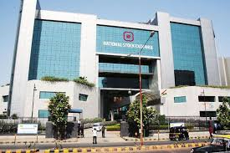

Slide 22
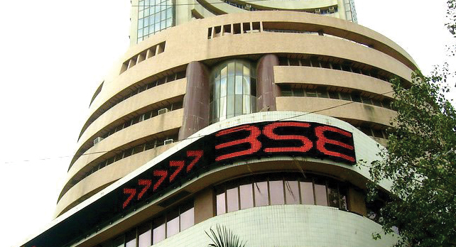

Slide 23
Functions of stock market

Slide 24
Provides continues and regular market for securities
Stock exchange provides a ready and continues market for purchase and sale of securities.
It also ensures stability in prices of securities.

Slide 25
Facilitates evaluation of securities
Stock exchange is useful for the evaluation of industrial securities.
This enables investors to know the true worth of their holdings at any time.
Comparison of companies in the same industry is possible through stock exchange quatations.

Slide 26
Encourage capital formation
Stock exchange accelerate the process of capital formation.
It creates the habit of saving, investing and risk-taking among the investing class and converts their savings into profitable investment.
It acts as an instrument of capital formation.

Slide 27
Provides safety and security in dealing
Stock exchange provides safety, security and equity in dealings as transactions are conducted as per well defined rules and regulations.
Fraudulent practices are also checked effectively.

Slide 28
Regulates company managements
Listed companies have to comply with the rules and regulations of concerned stock exchange and
Work under the vigilance of stock exchange authorities.

Slide 29
Facilitates public borrowings
Stock exchange serves as a platform for marketing government securities.
It enables the government to raise public debt easily and quickly.

Slide 30
Serves as economic barometer
Stock exchange indicates the state of health of companies and the national economy.
It acts as a barometer of the economic situation.

Slide 31
Stock exchange facilitates bank lending
Banks easily know the prices of quoted securities.
They offer loans to customers against corporate securities.

Slide 32
Listing of securities
Listing of securities is one useful services offered by stock exchanges to investors and borrowing companies.
The company whose securities are included in the official list is called a listed company.
Securities become eligible for trading only through listing.
For listing, a company has to apply to the stock exchange authorities with necessary documents and fees.

Slide 33
Listing is not compulsory in India but it gives prestige to the company.
Listing is compulsory to those companies which intend to offer securities to the public for subscription by issuing prospectus.

Slide 34
Advantages of listing of securities
Widens market
Easy marketability
Easy publicity
Creates good will
Quick marketing

Slide 35
Disadvantages of listing of securities
No guarantee about safety to investors
Listed companies suffers when share prices go down.
Listing is not obligatory
Lengthy procedure
Disclosure of information by listed companies.
Encourage large scale purchase by interested parties.
Listed company may collect huge capital but may not use it properly.

